Slide 1
JVM GC Tuning
Mei Canhua

Slide 2
Agenda
Process Memory Model
HotSpot JVM Architecture
JVM Tuning Goals
Heap & Generation Size Adjustments
Collector Choices
Tips for HGoS
Q&A

Slide 3
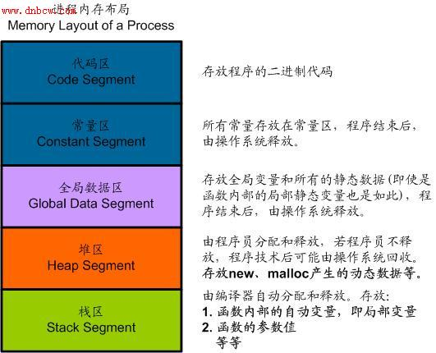
Memory Layout Of a Process

Slide 4
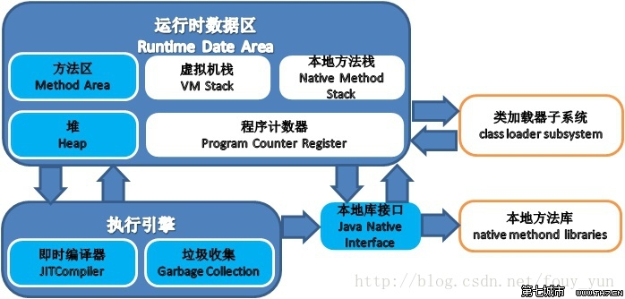
HotSpot JVM Architecture
Notes:
每个方法被执行的时候都会同时创建一个栈帧（Stack Frame）用于存储局部变量表、操作栈、动态链接、方法出口
等信息。每一个方法被调用直至执行完成的过程，就对应着一个栈帧在虚拟机栈中从入栈到出栈的过程。

Slide 5
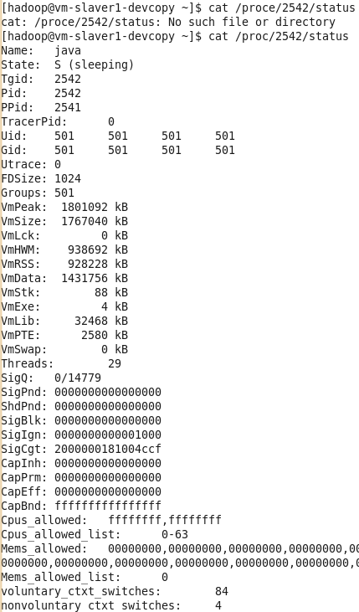
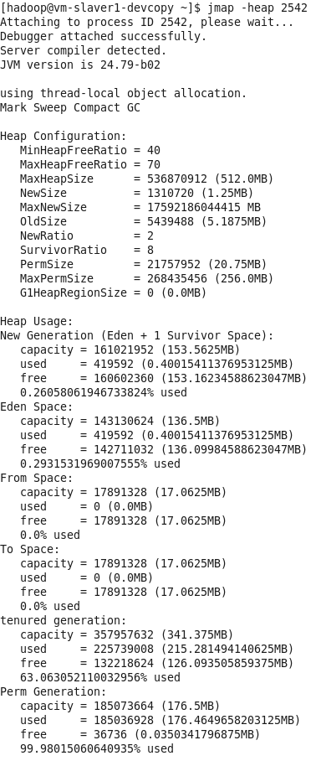
系统内存 JVM内存
Notes:
VmLck:正在锁住的物理内存
VmHWM：使用的物理内存的峰值
VmRSS：当前正在使用的物理内存
VmData：

Slide 6
JVM Tuning Goal
Maximum Pause Time Goal
-XX:MaxGCPauseMillis=<nnn>
Throughput Goal
-XX:GCTimeRatio=<nnn>.
Throughput=1 / (1 + <nnn>)
-XX:GCTimeRatio=19 sets a goal of 1/20th or 5% of the total time for garbage collections
Footprint (Heap Size)
GC Logs
Notes:
Pauses are the times when an application appears unresponsive because garbage collection is occurring.
Throughput is the percentage of total time not spent in garbage collection considered over long periods of time. Throughput includes time spent in allocation (but tuning for speed of allocation is generally not needed).
If the throughput and maximum pause time goals have been met, then the garbage collector reduces the size of the heap until one of the goals (invariably the throughput goal) cannot be met. The goal that is not being met is then addressed.

Slide 7
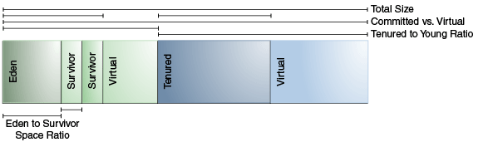
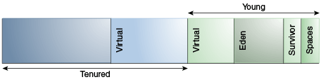
Heap & Generation Size Adjustments
Xms Xmx NewRatio NewSize MaxNewSize SurvivorRatio
https://docs.oracle.com/javase/8/docs/technotes/guides/vm/gctuning/toc.html

Slide 8
Collector Choices
Serial -XX:+UseSerialGC
Single processor
Simple and efficient relatively
Client
Multiprocessors for applications with small data (<100M)
Parallel -XX:+UseParallelGC
Application with Medium-size/large-size data size
Throughput goal (Throughput collector)
Multiprocessors
Notes:
When does the choice of a garbage collector matter?
For some applications, the answer is never.
That is, the application can perform well in the presence of garbage collection with pauses of modest frequency and duration. However, this is not the case for a large class of applications, particularly those with large amounts of data (multiple gigabytes), many threads, and high transaction rates.
The collector will be selected by default according to hardware and system configurations.

Slide 9
Collector Choices
Concurrent-Mark-Sweep -XX:+UseConcMarkSweepGC
Applications with medium-size/large-size data sets
Response time is more important than overall throughput
Only use in old generation
will be replaced by G1
Concurrent collection cycle
Initial mark(STW, single-thread)
Concurrent mark
Concurrent pre-clean[part of remark work]
Remark(STW, multi-thread)
Concurrent sweep
Concurrent reset
Notes:
Stop all application threads, identify the set of objects reachable from roots, and then resume all application threads.
Concurrently trace the reachable object graph, using one or more processors, while the application threads are executing.
Concurrently retrace sections of the object graph that were modified since the tracing in the previous step, using one processor.
Stop all application threads and retrace sections of the roots and object graph that may have been modified since they were last examined, and then resume all application threads.
Concurrently sweep up the unreachable objects to the free lists used for allocation, using one processor.
Concurrently resize the heap and prepare the support data structures for the next collection cycle, using one processor.

Slide 10
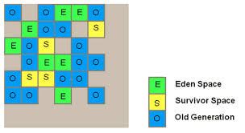
Collector Choices
G1 -XX:+UseG1GC
Garbage-First, partition heap to equally sized regions
Multiprocessor machines with large memories(heapsize>6g)
Meets gc pause time goals with high probability while achieving high throughput

Slide 11
Collector Choices
More than 50% of the Java heap is occupied with live data.
The rate of object allocation rate or promotion varies significantly.
The application is experiencing undesired long garbage collection or compaction pauses (longer than 0.5 to 1 second).
Phases of the G1 Marking Cycle
Initial marking phase (STW)
Root region scanning phase
Concurrent marking phase
Remark phase (STW )
Cleanup phase (partly concurrent )
Notes:
Initial marking phase (STW)
mark roots, This phase is piggybacked on a normal (STW) young garbage collection.
Root region scanning phase
scans survivor regions marked during the initial marking phase for references to the old generation and marks the referenced objects
concurrently ,must complete before the next STW young garbage collection can start.
Concurrent marking phase
GC finds reachable (live) objects across the entire heap
can be interrupted by STW young garbage collections
Remark phase (STW )
Completes marking (SnapshotAtTheBeginning[SATB] buffer (other GC use dirty card algorithm)) , traces unvisited live objects
Reference processing
Cleanup phase
Liveness accounting and identify completely free regions (STW)
Remembered Set scrubbing (STW)
Reset the empty regions and return them to the free list (Concurrent)

Slide 12
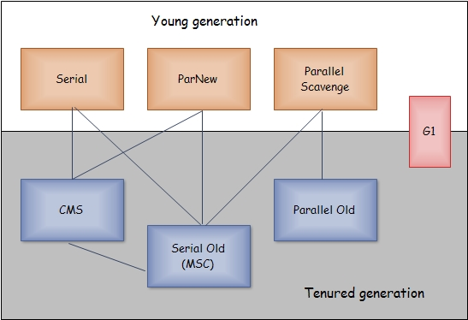
Collector Choices

Slide 13
Tips for HGoS
As for data loading tasks, we can try the following tips:
Driver Program
Set larger size for old generation
Use G1 Collectors
Executors
Set larger size for new generation

Slide 14
Q&A THANKS

